Slide 1

Information session on
Muslim Funerals
Brisbane

Slide 2

Muslim Funeral Services Ltd
Dr.Mohammed Iqbal Sultan
Director MFS
Notes:
ASA
Rabbi shrahli sadri wa yassirli wahlul ook datum millisani, yafkahoo kawli
ASA respected imams and to one and all
On behalf of MFS Thank you for taking the time to attend this session. We hope to share some information about the services we provide and some insight on what you may do in the event of a funeral in your family
For those who may not know me I am MIS, I am a Medical doctor and today presenting as a Directors of MFS. I am not an Imam or Religious scholar by any means.

Slide 3

The Quran says:
“Kullu nafsin tha-iqathul maut”
Every soul shall have a taste of death
“Inna lillahi wa inna ilaihi raji’un”
To Allah SWT we belong and unto Him we shall return
Notes:
The Quran says
Ben Franlin says
And today we will talk about death within the context of Islam

Slide 4
About Islamic Funerals
Fard-e-kifayah – an obligatory act which if performed by a one member of a community, absolves the entire community of the responsibility, and if not, then the entire community is sinful and accountable
Family and community involvement
Notes:
Funeral Director has been outsourced till MFS

Slide 5
Today …
About MFS
About Islamic Funerals
What to do when death occurs?
The funeral process
Ghusl procedure
Funeral Savings Plan
ALL information on our website

Slide 6
About MFS
  Established 2010 - ASIC registered company
  Autonomous Independent of any Musjid
  Funeral Director SEQ Muslim Community
  Based at Kuraby Musjid but serve entire community of Southeast Queensland / Gold Coast
  Not for profit Company / Committee of volunteers
Notes:
Give a brief overview of the presentation. Describe the major focus of the presentation and why it is important.
Introduce each of the major topics.
To provide a road map for the audience, you can repeat this Overview slide throughout the presentation, highlighting the particular topic you will discuss next.

Slide 7
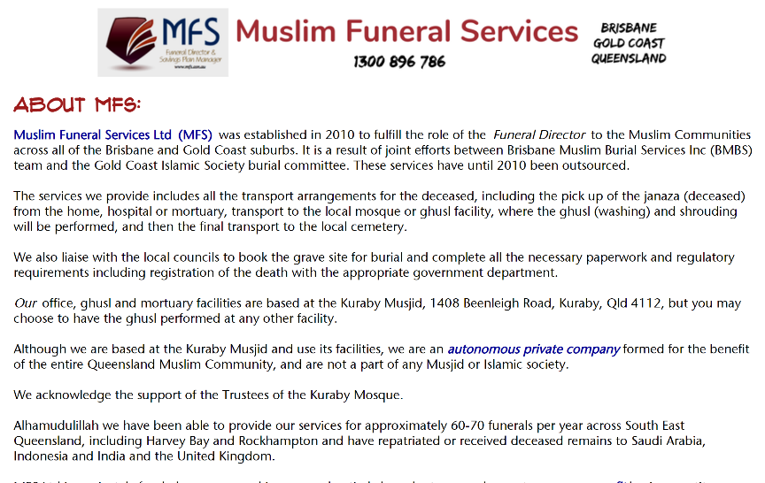
Notes:
Web page

Slide 8
MFS Committee
Yussuf Chothia
Dr. Mohammed Iqbal Sultan
Riaz Gutta
Hussin Goss (Gold Coast)
Notes:
This is another option for an overview using transitions to advance through several slides.

Slide 9
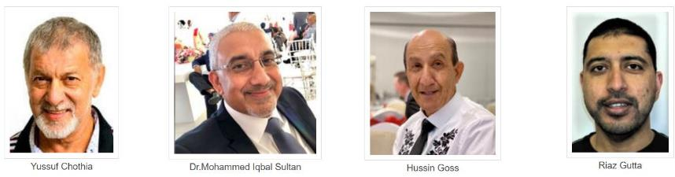
The Team
Ziyaad Chothia
Farida Lambat (Admin)
Male Volunteers (Brothers Arif & Ismail)
Female Voulnteers (Omi Youcef & her team)

Slide 10
Services Offered:
Full Funeral Director services
All transport arrangements
Grave bookings
Pick up hospital, mortuary or home to Ghusl facility
Liaise with Hospital, Police, Coroner's office or mortuary
Complete all regulatory paperwork
Death Registration with Dept of Births, Deaths & Marriage

Slide 11
Other Services
Interstate / Overseas transfers in and out
Embalming
Burials at Mt Gravatt, Gold Coast, Coomera, Hemmant (2021), Toowoomba, Beenleigh
Still born Burials at Mt Gravatt & Beenleigh

Slide 12
SMS Service:
Free SMS for funerals taking place in SEQ
Database of nearly 900
To get onto our database – send an email to admin@mfs.asn.au
online sms registration form at mfs.asn.au
Facebook @MuslimFuneralServicesBrisbane

Slide 13
Other activities:
Point of information for hospitals, police, other funeral directors
Education of other non-Muslim funeral directors in small towns thro our QFDA membership
Presentation to AFDA, Qld Crematorium Association, liaise with other Councils

Slide 14
MFS
Provide assistance to smaller Muslim communities across SEQ – Mackay, Rockhampton, Cairns, Toowoomba
Supply precut Kaffans (Shroud)
Local Council advocacy and representation to address burial needs of Muslims
Cemeteries in other areas / assisted setup Rockhampton Cemetery

Slide 15
Kuraby Facility
Offices at the Kuraby Musjid
Fully equipped Ghusl Room
Cold Room
Hearse facility
Storage facility
Manufacture all boxes for burial
Kaffan packaging Mortuary
Hearse
Notes:
This is another option for an overview using transitions to advance through several slides.

Slide 16
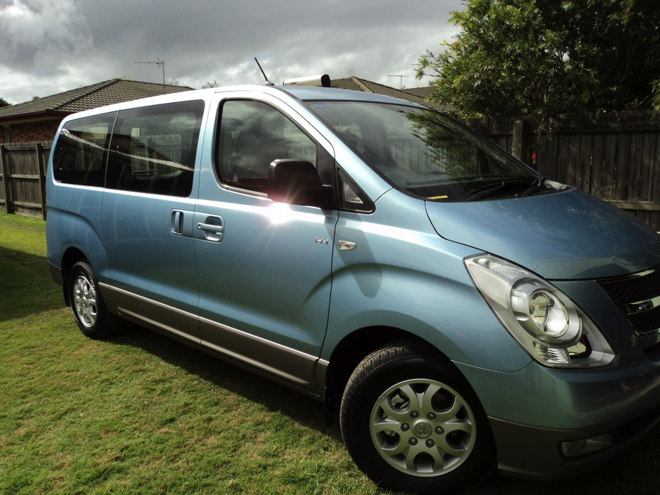
MFS Hearse

Slide 17
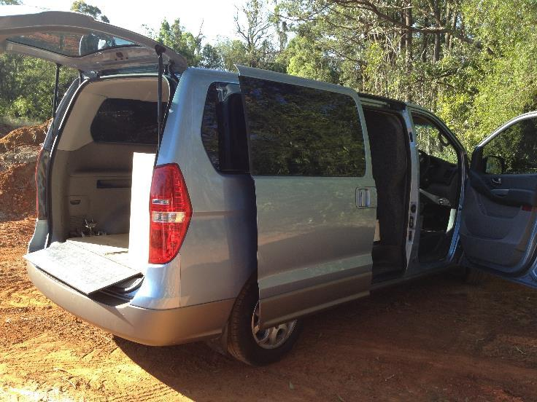

Slide 18
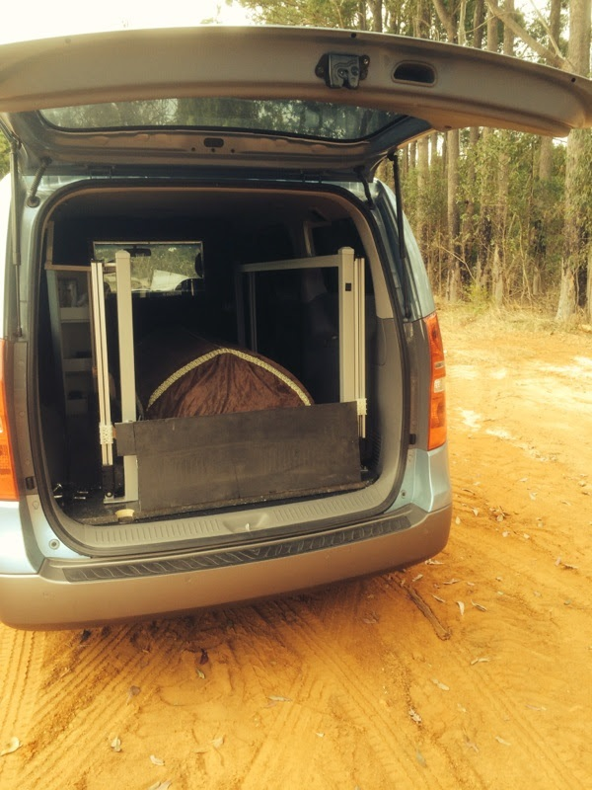

Slide 19
~ 80 per year now
~ 750 Funerals performed
Funerals done
About 25% stilllborn

Slide 20
About Muslim Funerals
Burial as soon as possible – usually within 24 hours
Death Certificate ASAP
No Cremations
No need for embalming (exceptions)
Postmortems discouraged
No Coffins
Burial directly on ground

Slide 21
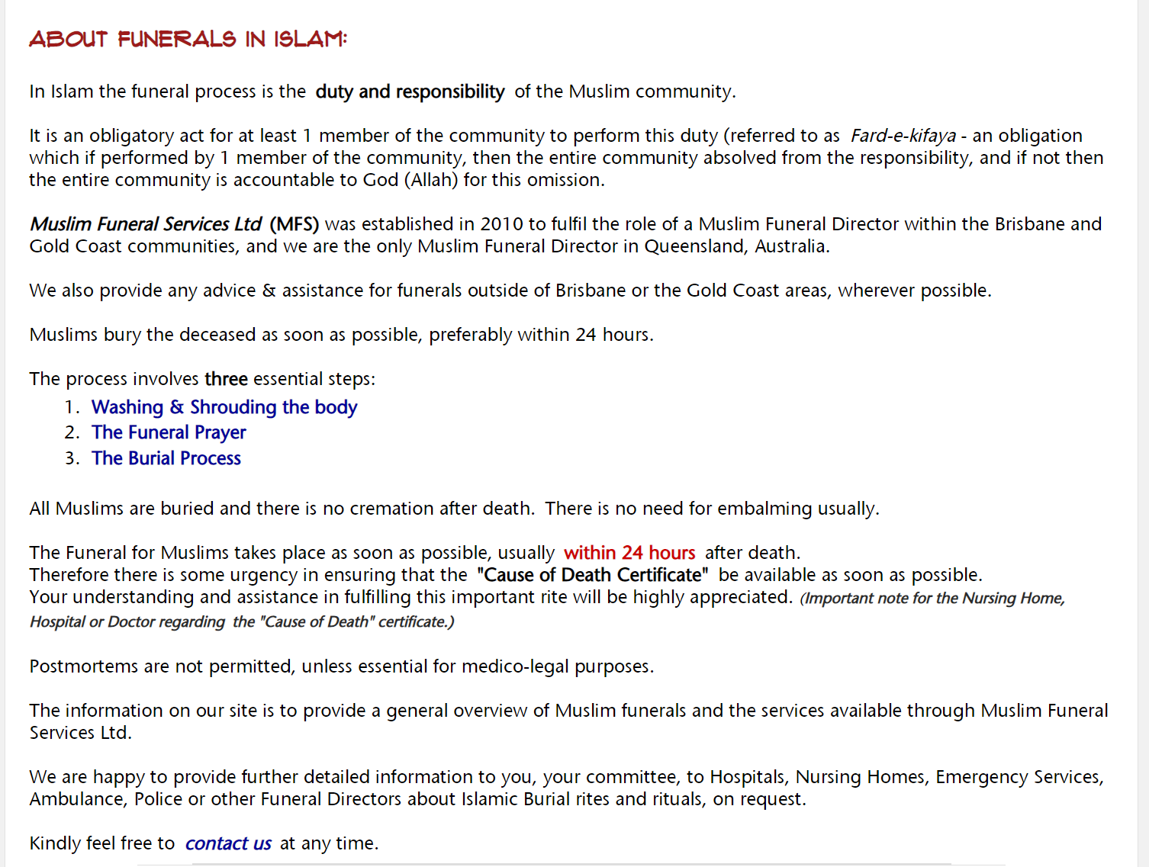

Slide 22
When death expected:
Contact MFS prior to death
Complete online forms
Advise Doctor, Hospital or Nursing home patient is Muslim
Need for the death certificate ASAP
Complete all Forms
When death occurs contact MFS 24/7
Remain at hospital till arrangement for death certificate is made

Slide 23
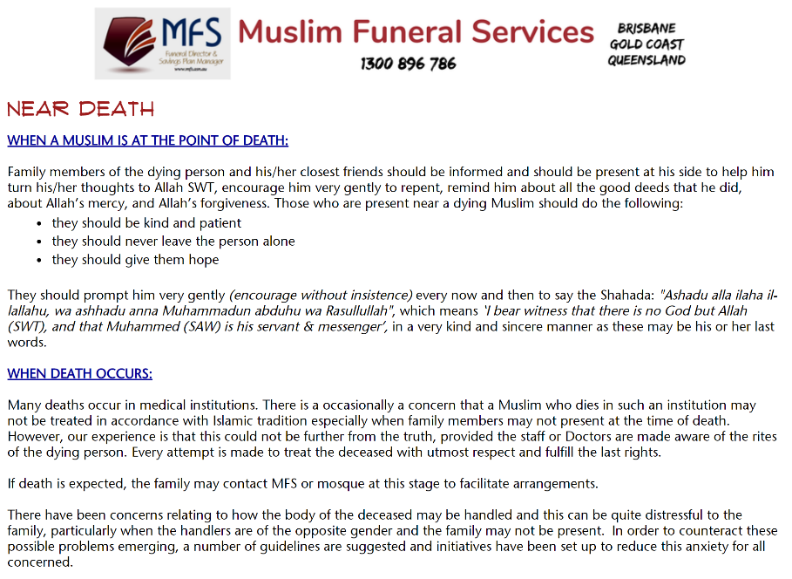

Slide 24
When death occurs
Remove any tubes, false teeth, contact lenses or artificial limbs
Any incisions plugged so as to prevent a flow of blood
Close the eyes of the deceased
Close mouth by using strip of cloth or bandage
Ankles must be fastened together with a bandage or strip of
Arms must be placed straight down the side of the body fingers straight
The body, still fully clothed, should then be wrapped in a sheet

Slide 25
When death occurs:
1
2
Contact GP
3
Arrange Death Certificate
Contact QAS / MFS
Notes:
This is another option for an overview slide.

Slide 27
Forms: (all available on website)
Application & Consent Form
Authority to release from Hospital
Cemetery Application Form
BDM Registration done by MFS now

Slide 28
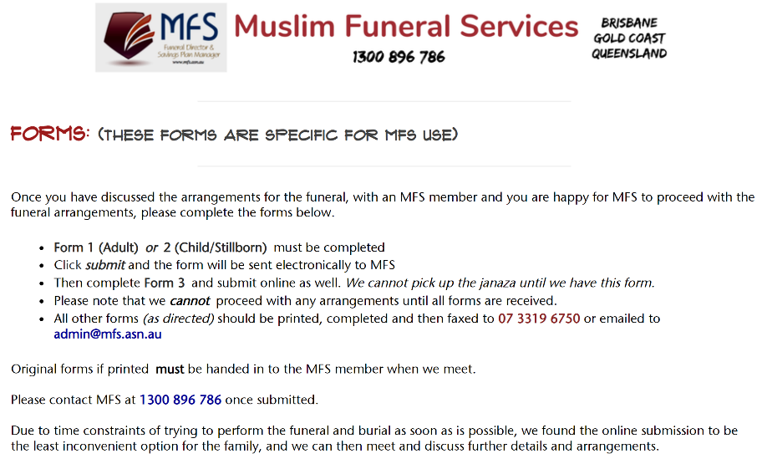

Slide 29
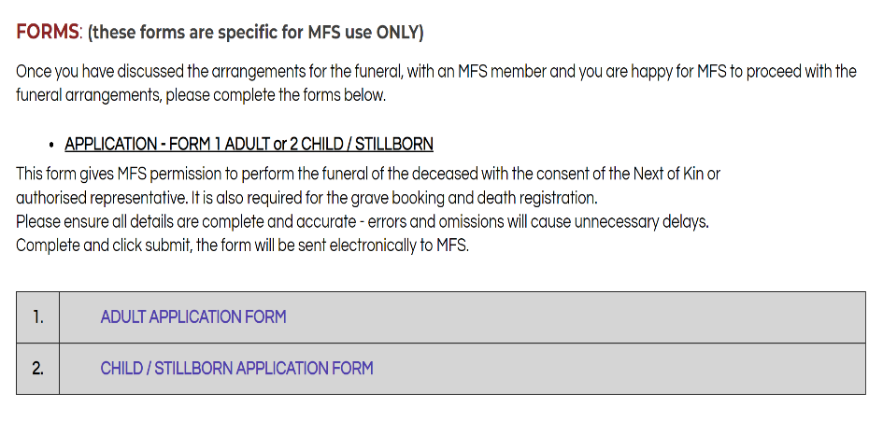
Application & Consent Form

Slide 30
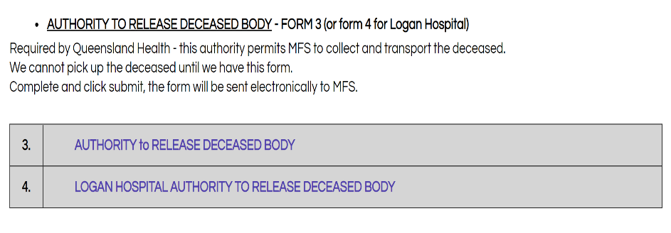
Authority to Release Janaza

Slide 31
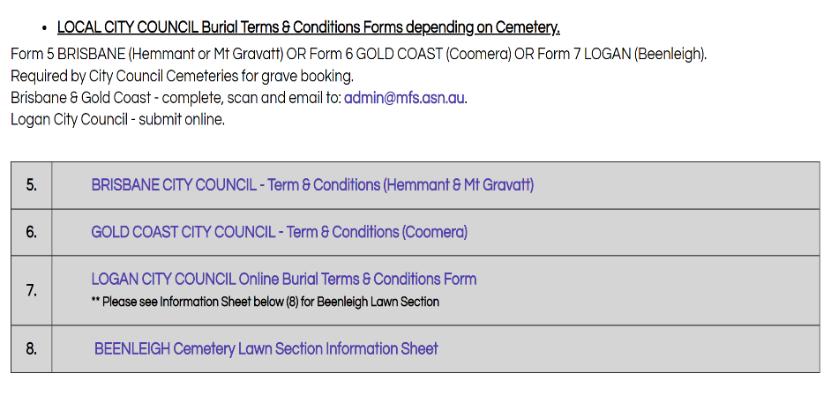
Local Council Application Form

Slide 32
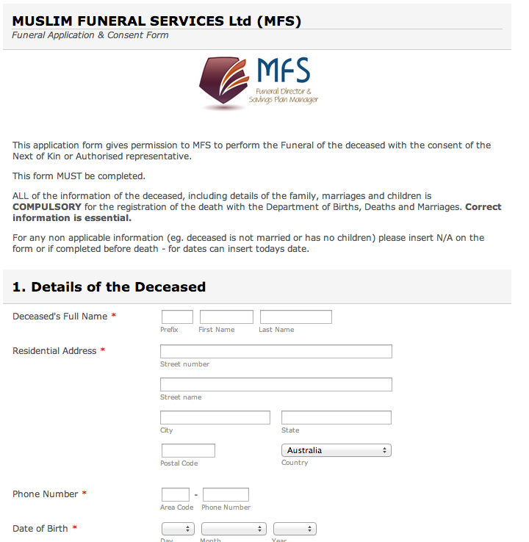

Slide 33
3 Steps
Washing and Shrouding
(Ghusl & Kaffan)
The Funeral Prayer
(Janazah Salah)
The Burial Process
(Al Daffan)

Slide 34
Ghusl & Kaffan
Most now done at the Kuraby Mosque facility in Brisbane and Gold Coast Musjid
May be at any other local Mosque which has a Ghusl facility
Janaza Salah
May take place at the mosque or at the cemetery

Slide 35
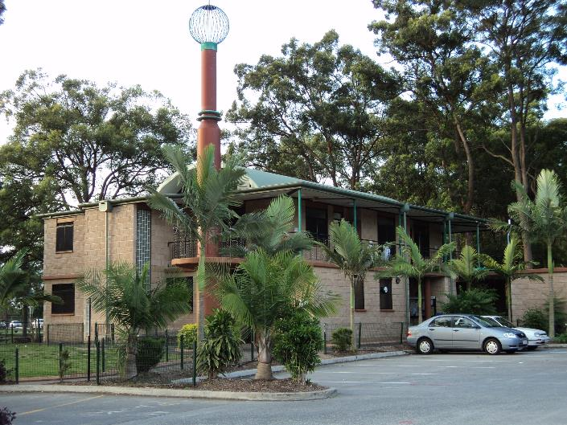

Slide 36
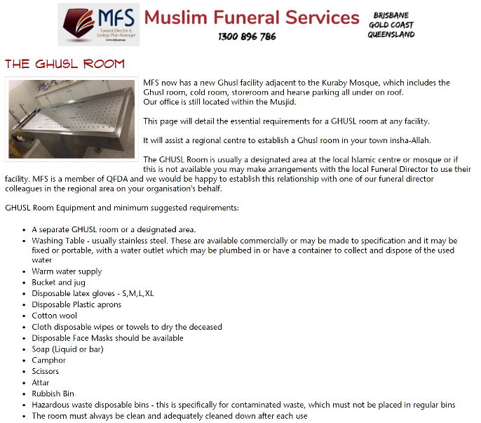

Slide 37
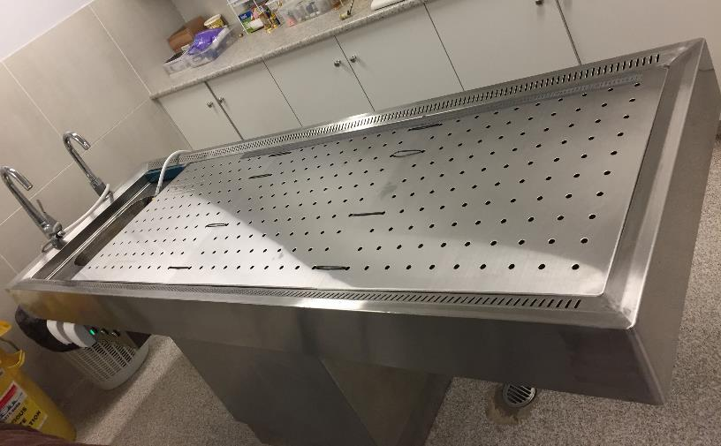
Ghusl table

Slide 38
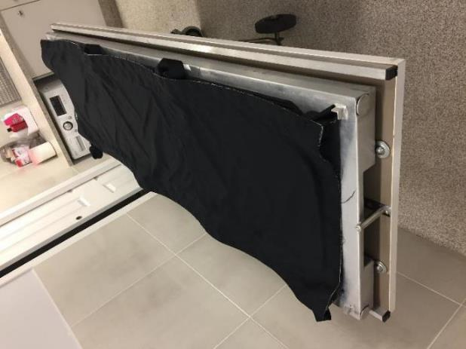

Slide 39
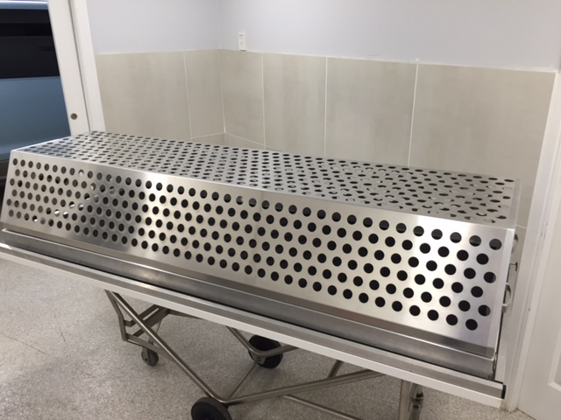

Slide 40
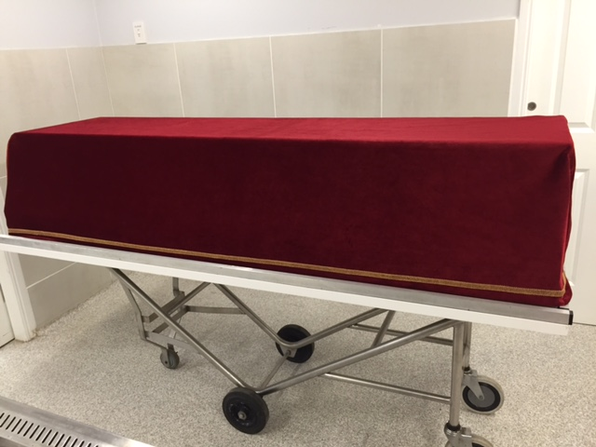

Slide 41
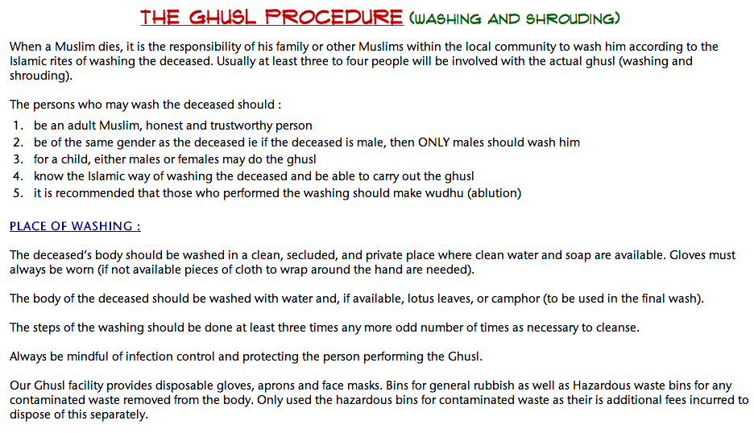

Slide 42
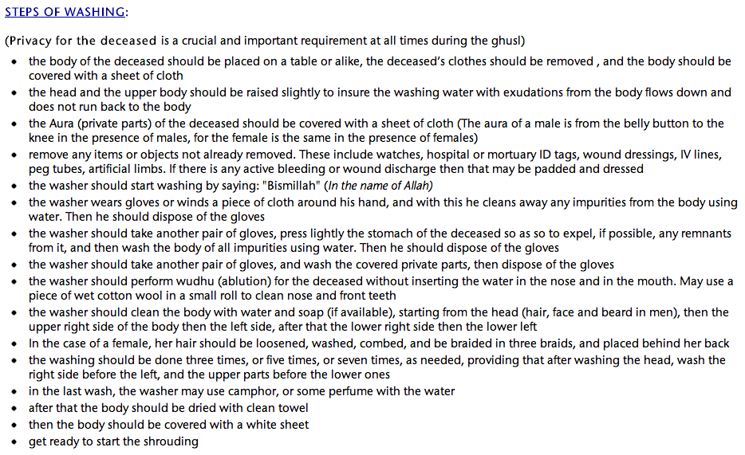

Slide 43
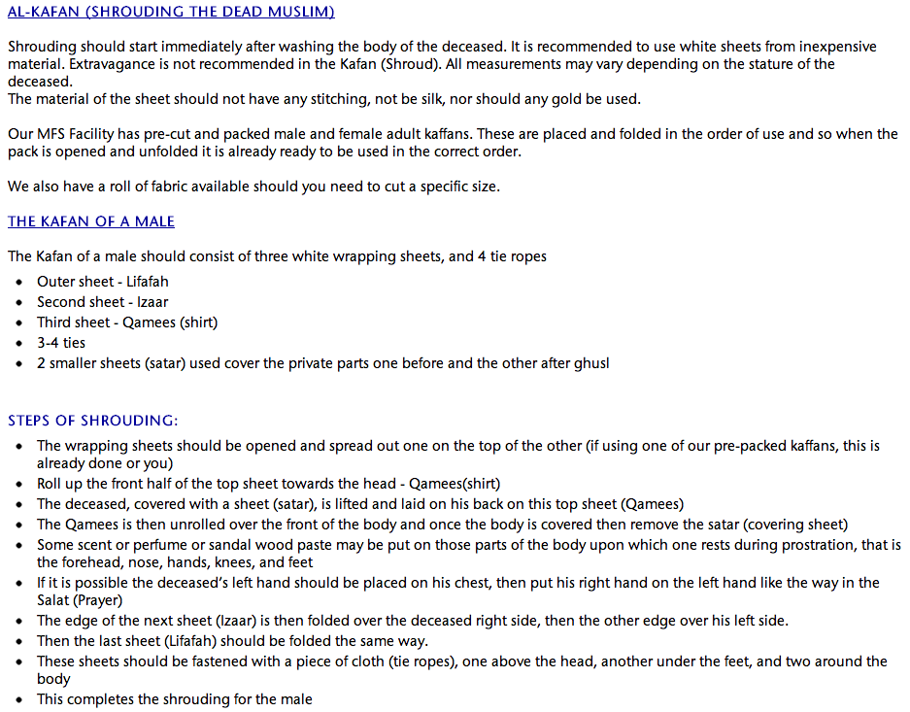

Slide 44
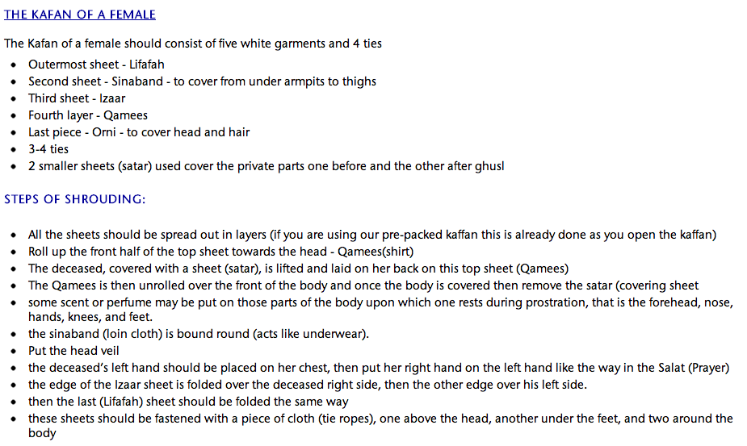

Slide 45
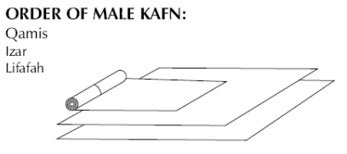
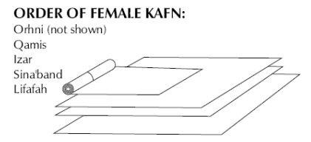
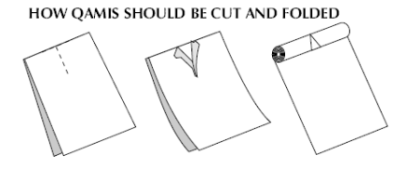

Slide 46
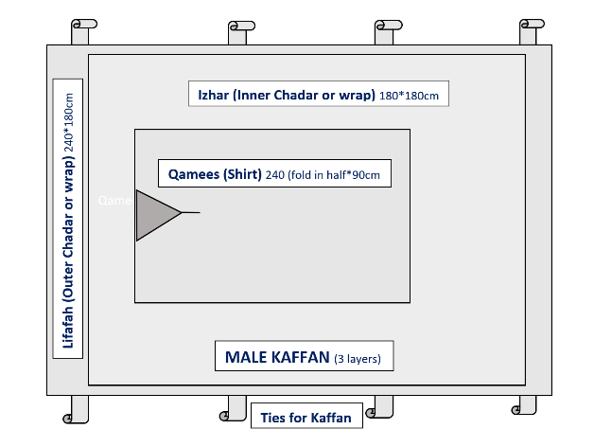
Male Kaffan

Slide 47
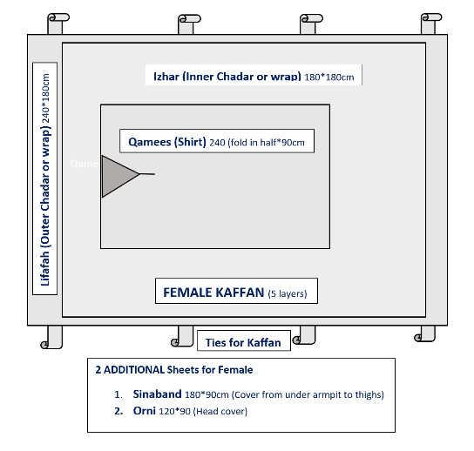
Female Kaffan

Slide 48
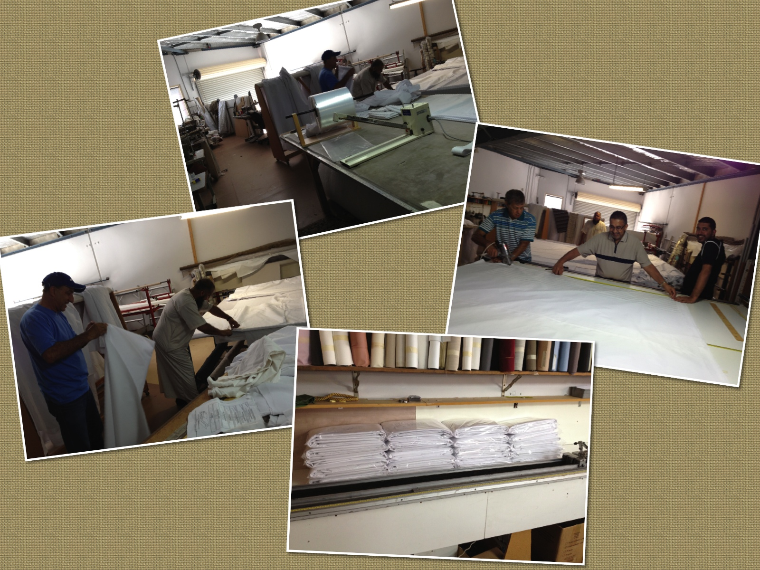
Kaffan cutting and packing

Slide 49
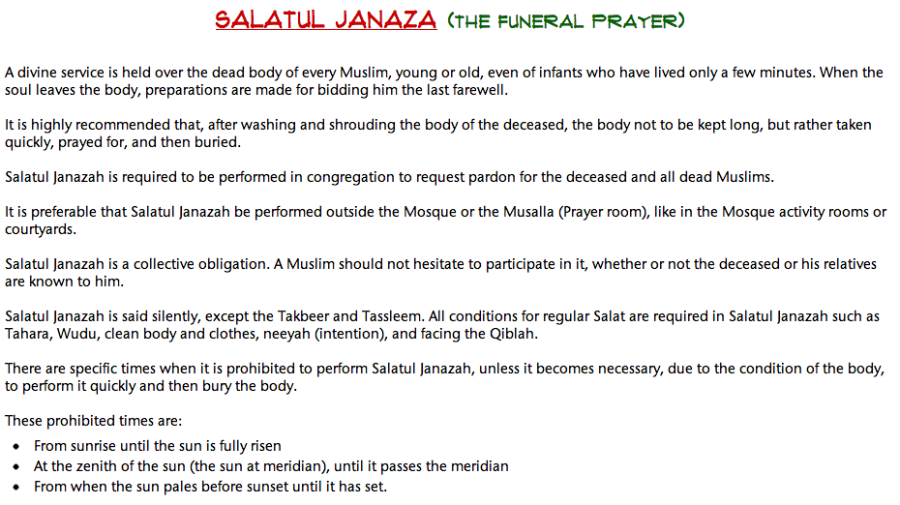

Slide 50
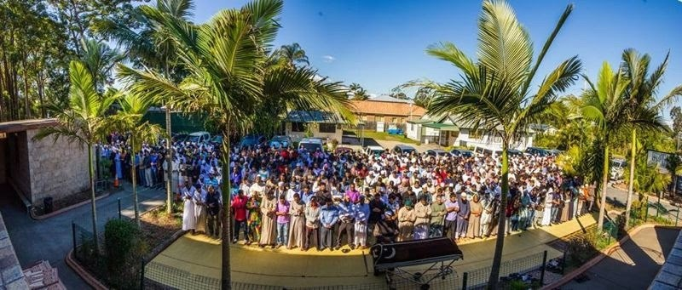
Janaza Salah Kuraby

Slide 51
Cemeteries
Adult & Children Burials:
    Mt Gravatt – new section
    Beenleigh – Lawn Cemetery
    Hemmant (2021)
    Gold Coast –Coomera
    Toowoomba
    Mackay & Rockhampton

Slide 52
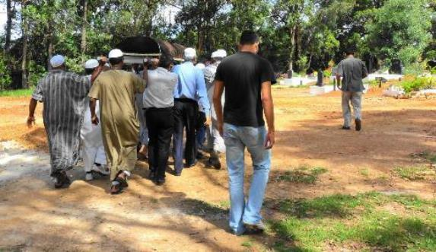
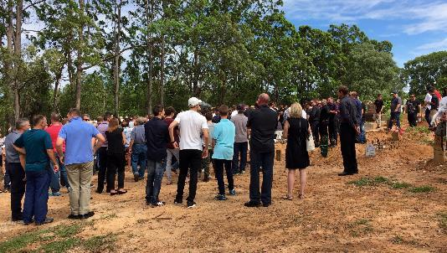
Mt Gravatt Cemetery

Slide 53
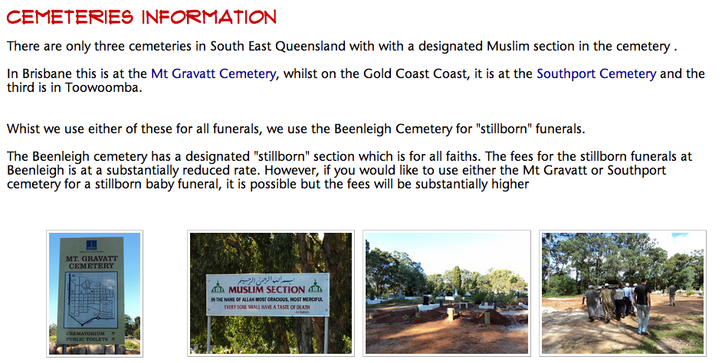

Slide 54
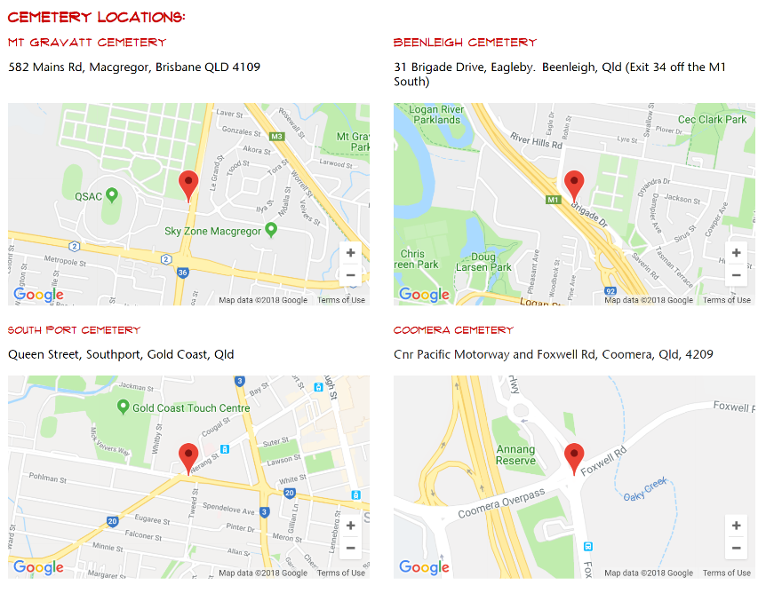

Slide 55
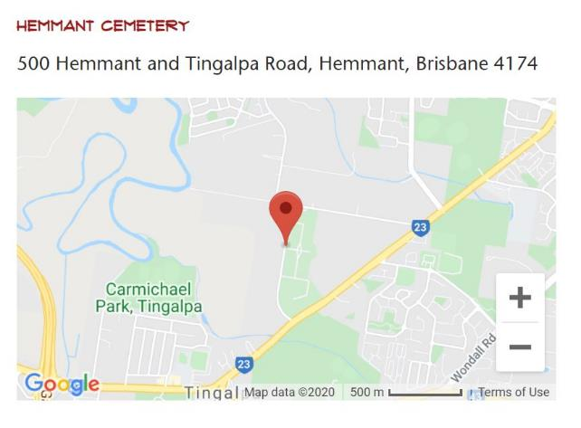

Slide 56
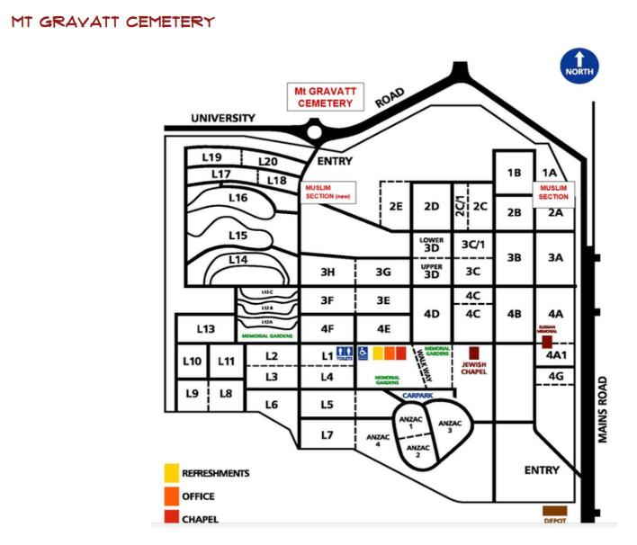

Slide 57
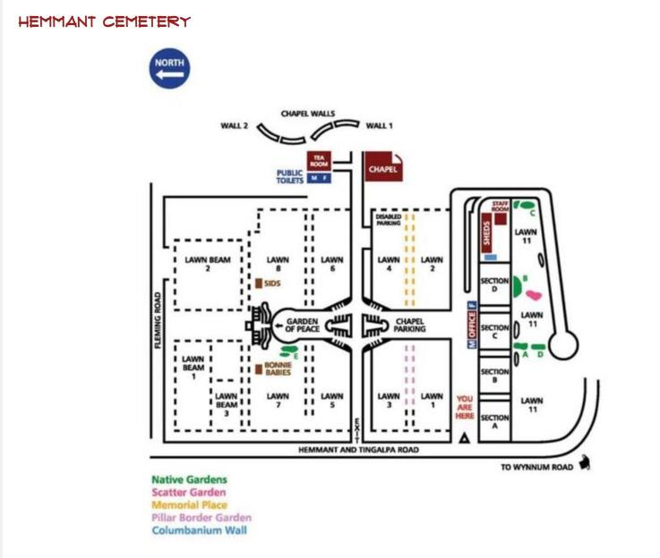

Slide 58
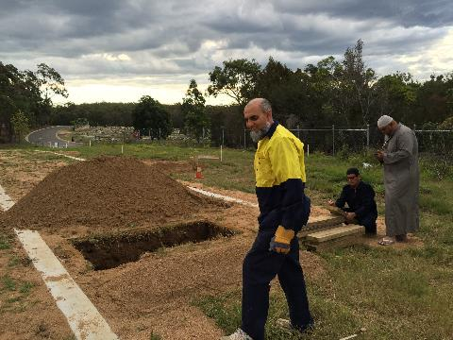
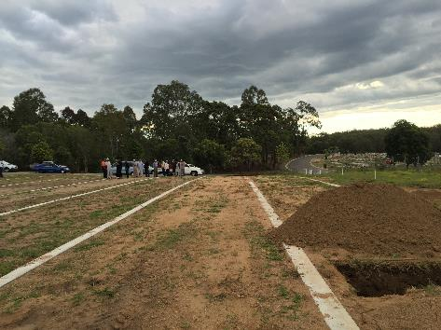
New section at Mt Gravatt cemetery

Slide 59
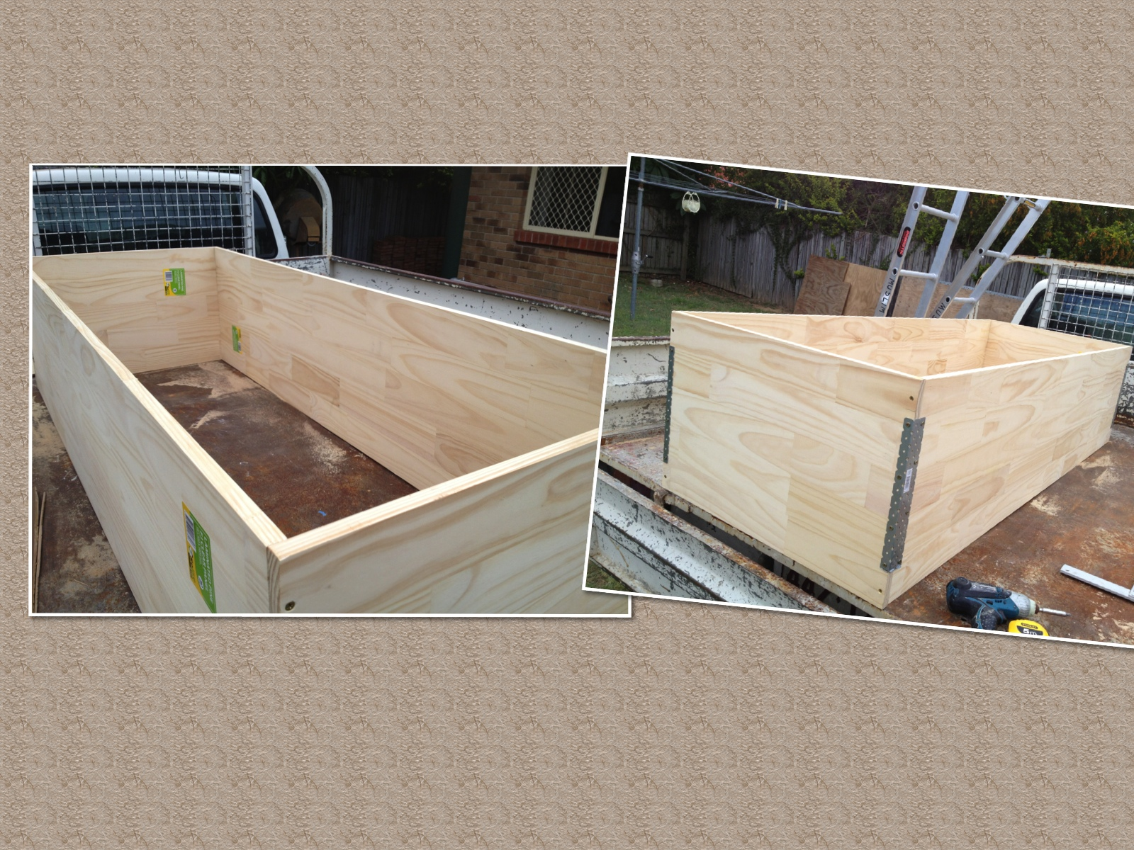
Internal Box for Grave

Slide 60
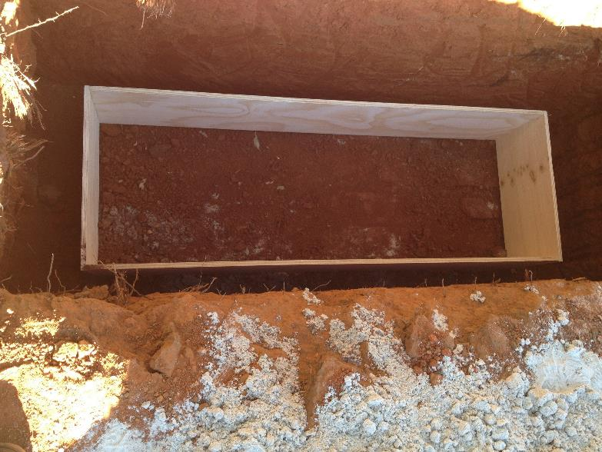
Internal Grave preparation

Slide 61
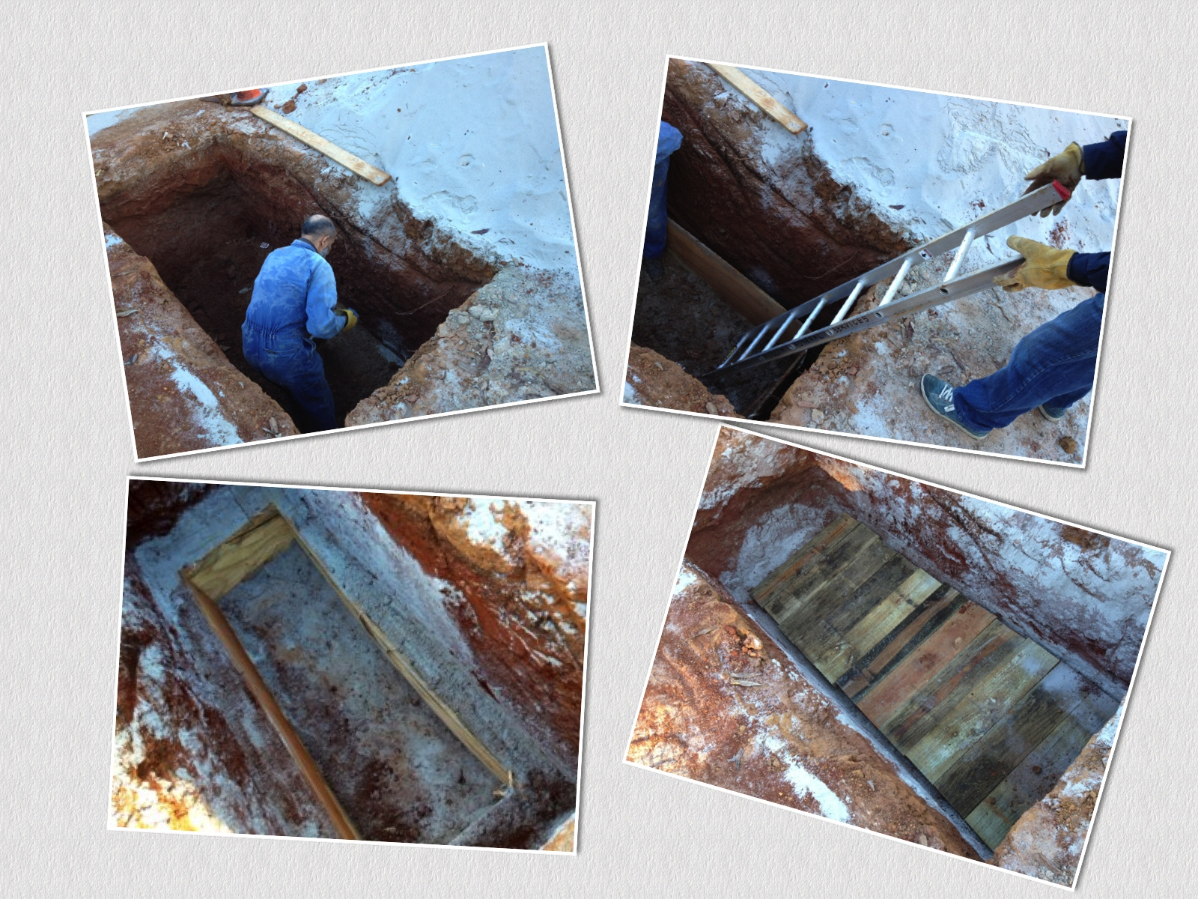
Grave being prepared
Grave covered
Box in Grave

Slide 62
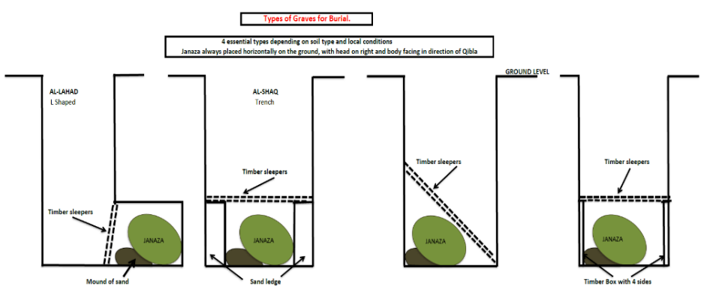
Grave shapes
Type used varies depending on soil type and local council regulations

Slide 63
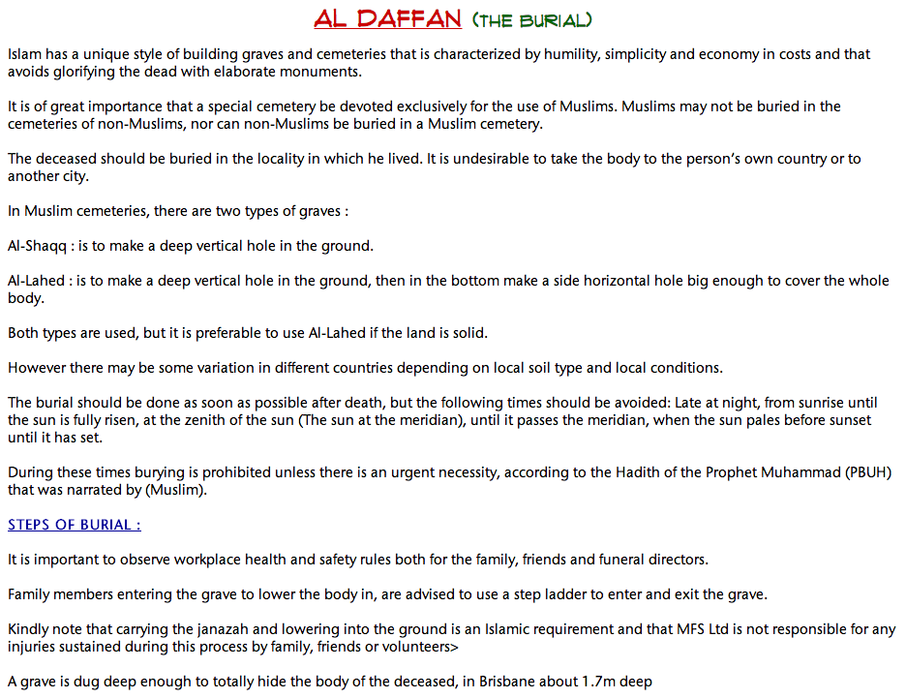

Slide 64
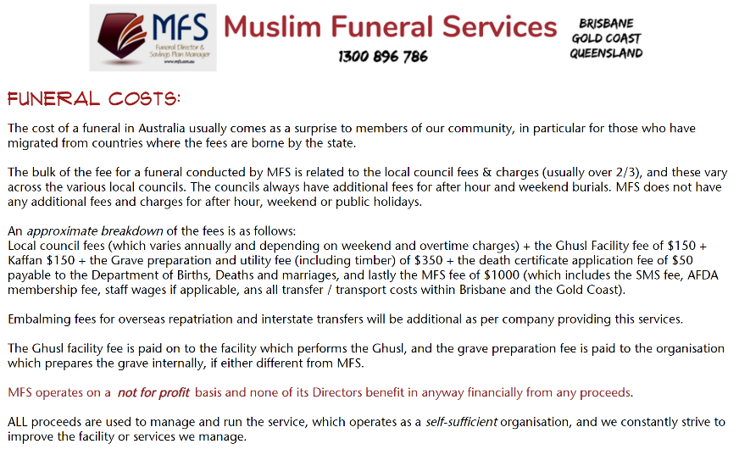

Slide 65
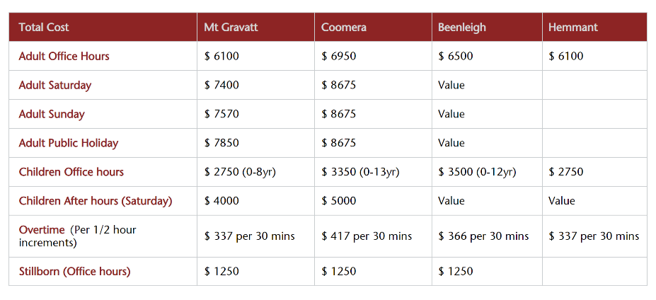
Total Funeral Costs

Slide 66
Funeral Savings Plan
MFS Savings Fund Manager
Monthly, quarterly, annual or lump sum contribution
What you put in is what you get out
No fees and charges
Family still responsible for any shortfall
Individual or Groups

Slide 69
Mixed Marriages
Discuss with family and advise family or spouse of your wish to be buried as a Muslim
Our experience has shown that the family goes out of their way to honour the wish of the deceased
When dealing with the diverse cultural backgrounds we all come from every funeral we do is so different
We make every effort to accommodate our brothers and sisters at this difficult time.

Slide 70
Other information on website
Islamic Will Kit
My Funeral wish
Quran Recitation
A complete Funeral Guide Booklet

Slide 71
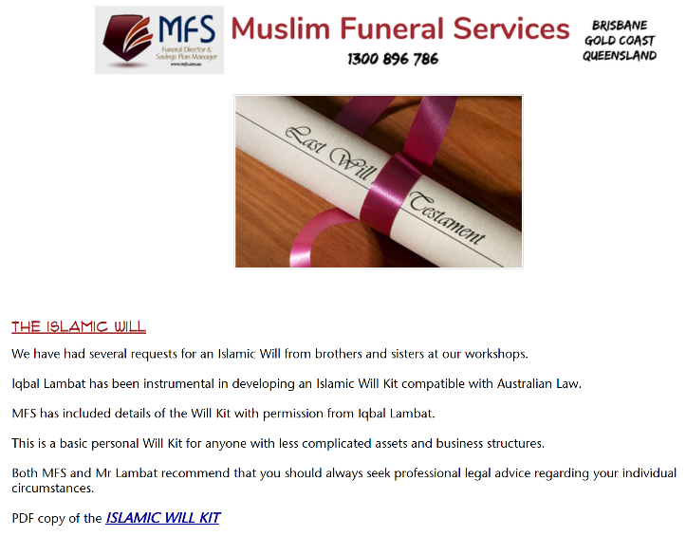

Slide 72
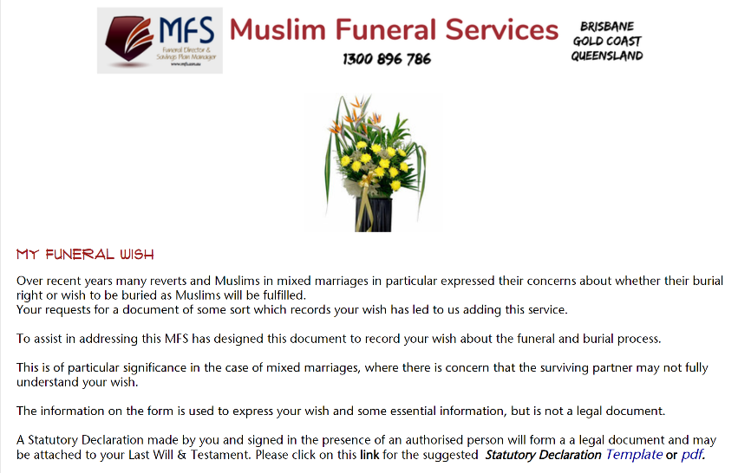

Slide 73
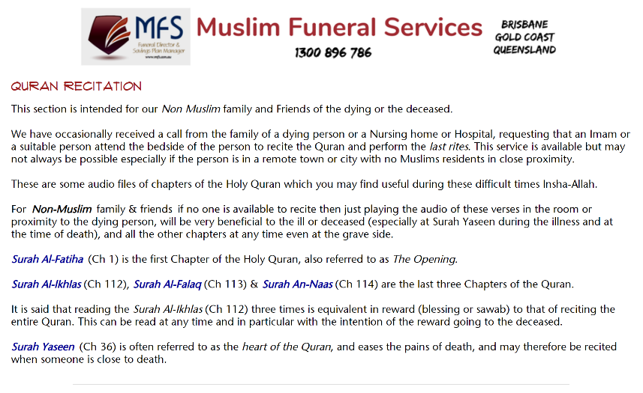

Slide 74
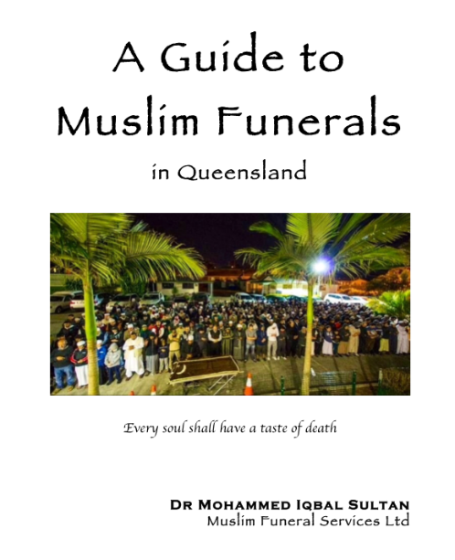

Slide 75


Slide 76


Slide 77
Coming up ….
Practical
GHUSL CLASS

Slide 78
Person performing Ghusl
Adult Muslim – minimum 3/4
Same gender as deceased (except in children)
Have wudhu
Knowledge of how to perform ghusl
Never share what is seen on janaza

Slide 79
Place of Ghusl
Ghusl room or private secluded place
Ghusl table
Warm water
Water outlet
Use protective clothing
Always use gloves

Slide 80
Place deceased on table
Remove body bag
Cover Auwra (private parts) with satar
Cut off clothes with scissors
Remove all clothes while covered
Keep Auwra covered at ALL times
Remove all tubes, jewelry, name tags

Slide 81
3 steps of Ghusl
Istinja
Wudhu
Ghusl

Slide 82
Istinja
Always wear gloves / no exceptions / Start with ‘Bismillah’
Remove watches, hospital ID tags, wound dressings, IV lines, peg tubes, artificial limbs
Pad and dress any active bleeding or wound
Wash away external impurities / Change gloves
Lift Janaza slightly
Apply gentle pressure to abdomen to expel any impurities, and wash off / Change gloves
Wash private parts whilst covered with satar at all times

Slide 83
Wudhu
Change gloves
Perform Wudhu
Wash hands of deceased
Clean nose and teeth rolled cotton wool
Wash face
Wash forearms to elbows / Make massa of head
Wash feet to ankles

Slide 84
Ghusl
Wash the body with water and soap
Starting from the head (hair, face and beard in men), females braid hair into 3 parts once washed
Then the upper right side of the body
Then the left side
Then the lower right side
Then the lower left side of Janaza

Slide 85
The washing done three times in same order
Final rinse, use camphor +- bay leaves with the water
Dry the body with clean towel by gentle dabbing
Then the body should be covered with a clean sheet
The Auwra must be kept covered at all times.
Get ready to start the shrouding

Slide 86
Open out Kaffan onto second table (be done before Ghusl commences)
Transfer the Janaza onto Kaffan on second table with satar in place
Sandal wood paste
Hands on side or like in Salah right over left
Cover with the rolled Qamees
Second layer Izhar folded right side of deceased, then left side
Final layer Lifafah folded in same order
Kaffan fastened with ties above head, mid abdomen & below feet

Slide 89
2 extra pices to female Kaffan

Slide 90

Contact Us

Slide 91

Make Dua Allah (SWT) guides us and gives us the ability to continue to provide this service

Slide 92

Thank you
Remember us all in your Duas
Questions Welcome
Ghusl Class follows …..

Slide 93
Dr.Mohammed Iqbal Sultan
MBChB, FRACGP
Family Health Clinic GP
Compton Mediclinic GP
Muslim Funeral Services (Director)
Islamic Medical Association (Founder)
Crescents of Brisbane (Treasurer)
Brisbane Islamic Centre (Vice President)
Lockyer Valley Islamic Association (Treasurer)

Slide 94
mfs.asn.au
1300 896 786
07 3319 6750
W
T
F

Slide 95

Questions

